Slide 1


Department of Information Science & Engineering
Dept. of ISE
CLOUD COMPUTING MODULE-1
Dr.Gulab Singh Chauhan
Professor Dept of ISE

Slide 2
Syllabus Module1: CLOUD COMPUTING
Introduction
Cloud computing at aGlance
Historical developments
Building Cloud computing Environments
Amazon web services
Google App engine
Micosoft Azure
Hadoop
Force.com and salesforce
Manjrasoft Aneka
Dept. of ISE

Slide 3
Cloud Computing:
Cloud Computing referred as the accessing and storing of data and provide services related to computing over the internet. It simply referred as it remote services on the internet manage and access data online rather than any local drives. The data can be anything like images, videos, audios, documents, files etc.
Cloud computing is adopted by every company, whether it is an MNC or a startup many are still migrating towards it because of the cost-cutting, lesser maintenance, and the increased capacity of the data with the help of servers maintained by the cloud providers.
Dept. of ISE

Slide 4
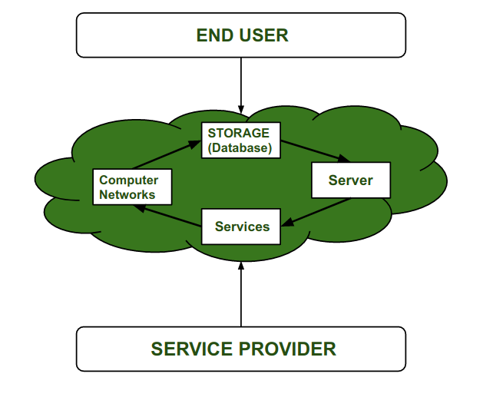
One more reason for this drastic change from the On-premises servers of the companies to the Cloud providers is the ‘Pay as you go’ principle-based services provided by them i.e., you only have to pay for the service which you are using. The disadvantage On-premises server holds is that if the server is not in use the company still has to pay for it.
Dept. of ISE

Slide 5
How Cloud Computing Works:
Cloud computing helps users in easily accessing computing resources like storage, and processing over internet rather than local hardwares. Here we discussing how it works in nutshell:
Infrastructure: Cloud computing depends on remote network servers hosted on internet for store, manage, and process the data.
On-Demand Acess: Users can access cloud services and resources based on-demand they can scale up or down the without having to invest for physical hardware.
Types of Services: Cloud computing offers various benefits such as cost saving, scalability, reliability and acessibility it reduces capital expenditures, improves efficiency.
Dept. of ISE

Slide 6
Service Providers of cloud:
Google Cloud
Amazon Web services (AWS)
Micosoft Azure
IBM Cloud
Alibaba Cloud
Dept. of ISE

Slide 7
Cloud computing has two models:
1. Deployement model : there are three types in the deployment model
A. Public
B. private
C. Hybrid
2.Service Model : There are three models in the service model they are
A. IAAS INFORMATION AS A SERVICE
B. PAAS PROCESS/PLATFORM AS A SERVICE
C. SAAS SOFTWARE AS A SERVICE
Dept. of ISE

Slide 8
Types of cloud:(Deployement Model)
1.Public :Services accessible by all People ex: Gmail
2.Private : services which can be accessed by only a specific people in a organization
3.Hybrid : It contain few services that come in public category and some services which are in private category.
4Community : Services which can be accessed by a group of people.
Pay for what you use is the advantage of the cloud services.
Dept. of ISE

Slide 9
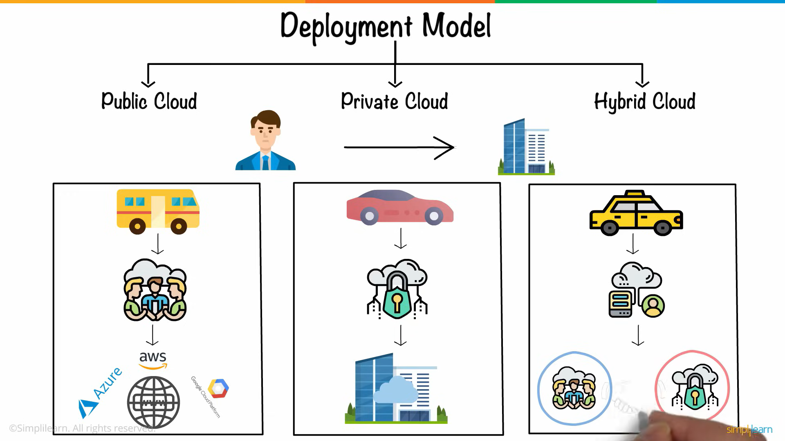
DEPLOYMENT MODEL:
Classification of Data Structure:
Classification of Data Structure
Dept. of ISE

Slide 10
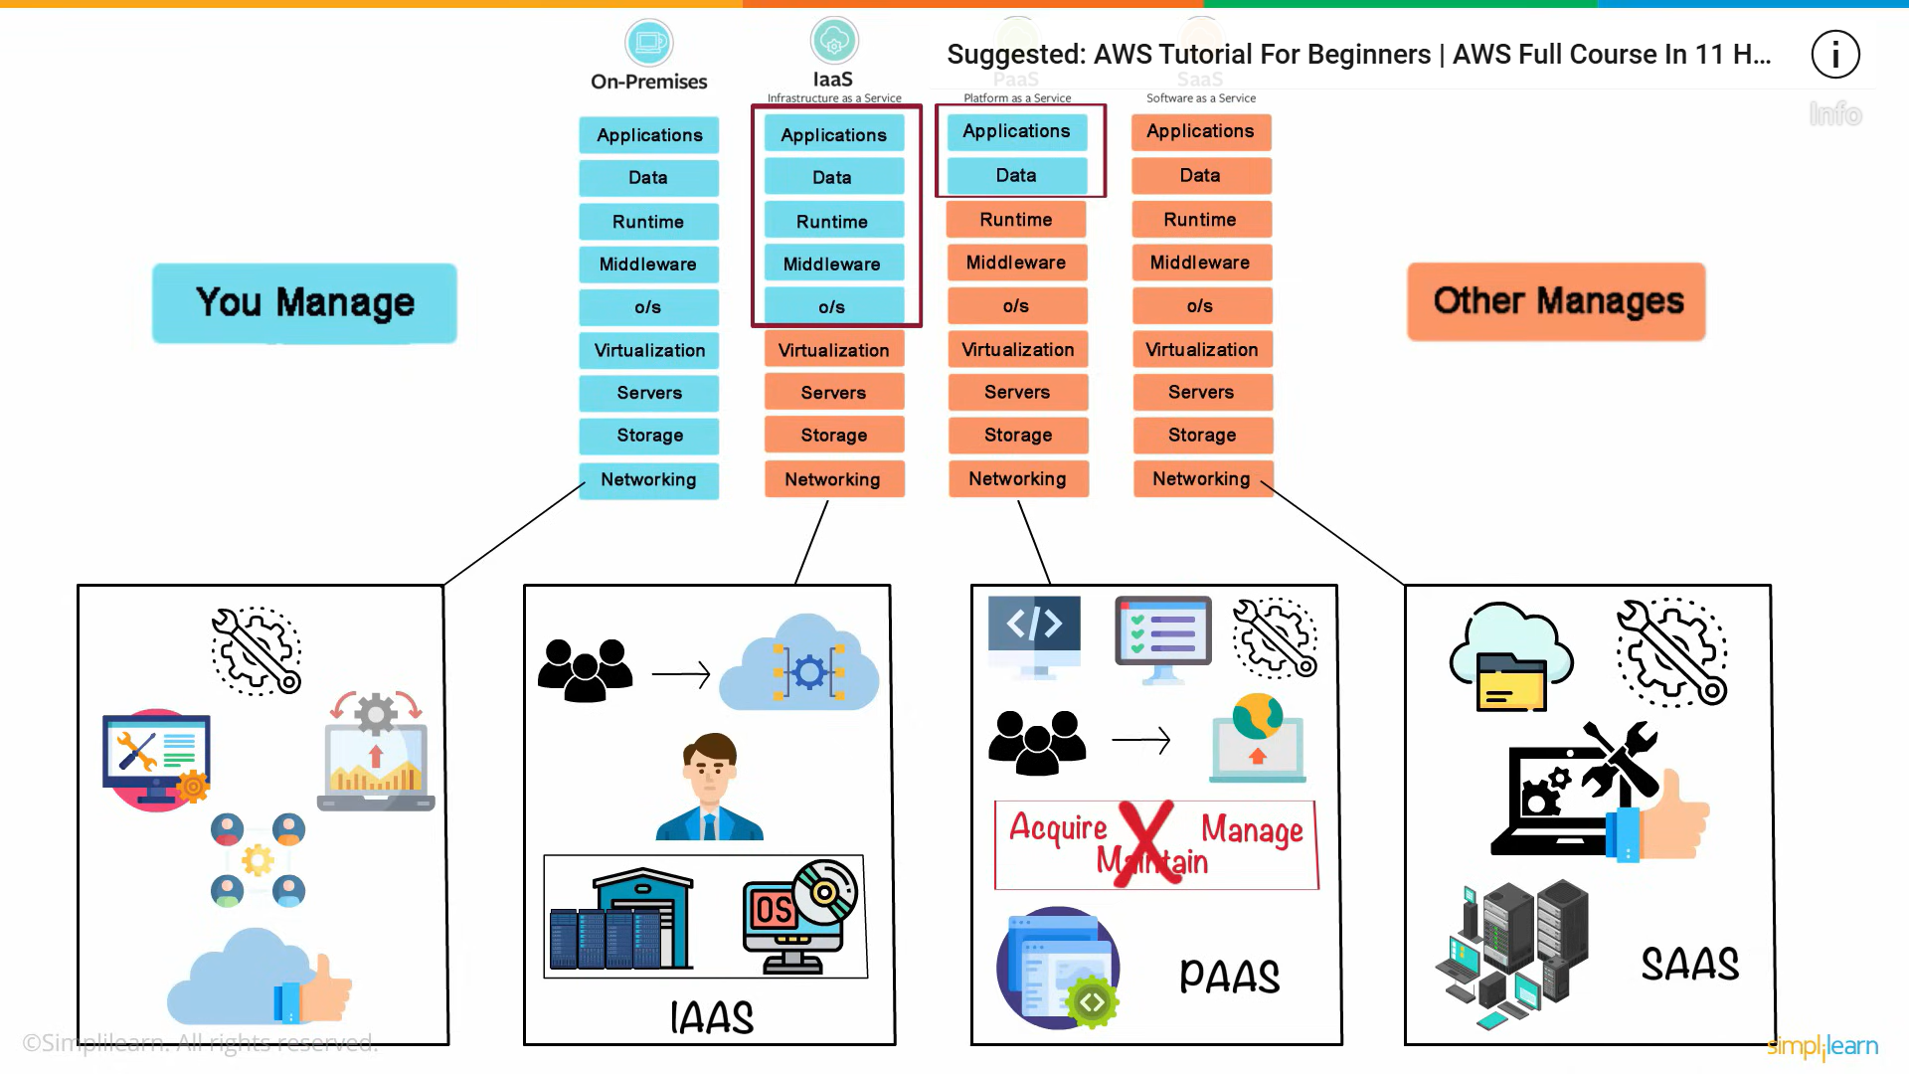
Classification of Data Structure:
Classification of Data Structure
Dept. of ISE

Slide 11
Comparison between a on premise and cloud system
ON PREMISE
1. Scalability No scope
2. Server Storage Limited and costly
3.Data Security Less and costly
4.Data recoverability Limited
5.Maintainance more
CLOUD SYSTEM
1.Scope is more on cloud system
2.Storage provided by cloud
3.Data security provided by cloud Servers
4.Data recovery is provided by cloud
5.Maintainance done by cloud servers
Dept. of ISE

Slide 12
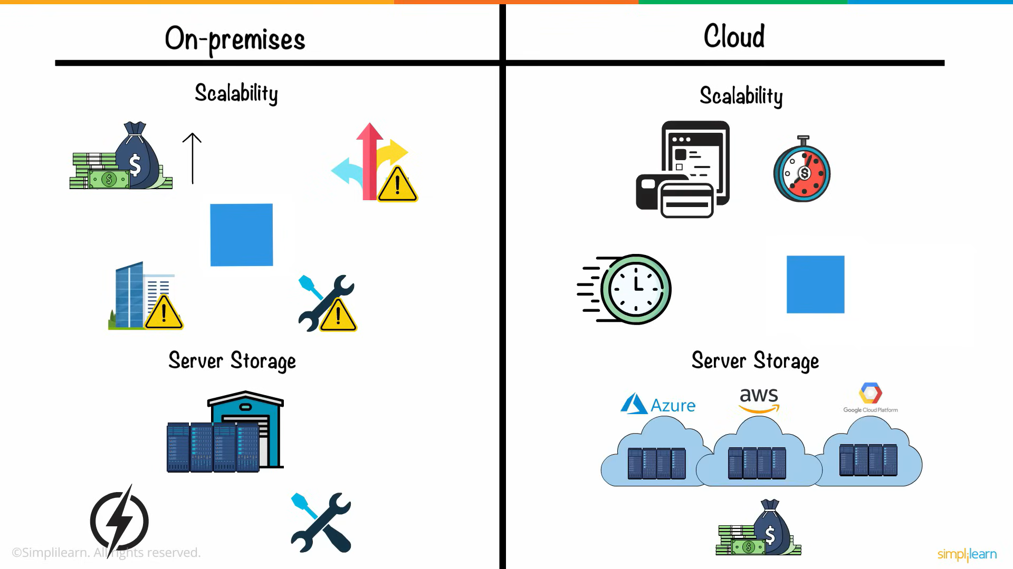
Classification of Data Structure:
Classification of Data Structure
Dept. of ISE

Slide 13
Classification of Data Structure:
Classification of Data Structure
History of Cloud Computing :
Before Computing was come into existence, client Server Architecture was used where all the data and control of client resides in Server side. If a single user want to access some data, firstly user need to connect to the server and after that user will get appropriate access. But it has many disadvantages. So, After Client Server computing, Distributed Computing was come into existence, in this type of computing all computers are networked together with the help of this, user can share their resources when needed. It also has certain limitations. So in order to remove limitations faced in distributed system, cloud computing was emerged.
Dept. of ISE

Slide 14
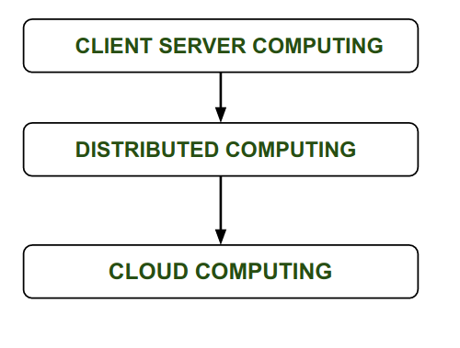
Classification of Data Structure:
Classification of Data Structure
Dept. of ISE
Evolution of cloud computing

Slide 15
Classification of Data Structure:
Classification of Data Structure
During 1961, John MacCharty delivered his speech at MIT that “Computing Can be sold as a Utility, like Water and Electricity.” According to John MacCharty it was a brilliant idea. But people at that time don’t want to adopt this technology. They thought the technology they are using efficient enough for them. So, this concept of computing was not appreciated much so and very less will research on it. But as the time fleet the technology caught the idea after few years this idea is implemented. So, this is implemented by Salesforce.com in 1999.
This company started delivering an enterprise application over the internet and this way the boom of Cloud Computing was started.
Dept. of ISE

Slide 16
Classification of Data Structure:
Classification of Data Structure
In 2002, Amazon started Amazon Web Services (AWS), Amazon will provide storage, computation over the internet. In 2006 Amazon will launch Elastic Compute Cloud Commercial Service which is open for Everybody to use.
After that in 2009, Google Play also started providing Cloud Computing Enterprise Application as other companies will see the emergence of cloud Computing they also started providing their cloud services. Thus, in 2009, Microsoft launch Microsoft Azure and after that other companies like Alibaba, IBM, Oracle, HP also introduces their Cloud Services. In today the Cloud Computing become very popular and important skill.
Dept. of ISE

Slide 17
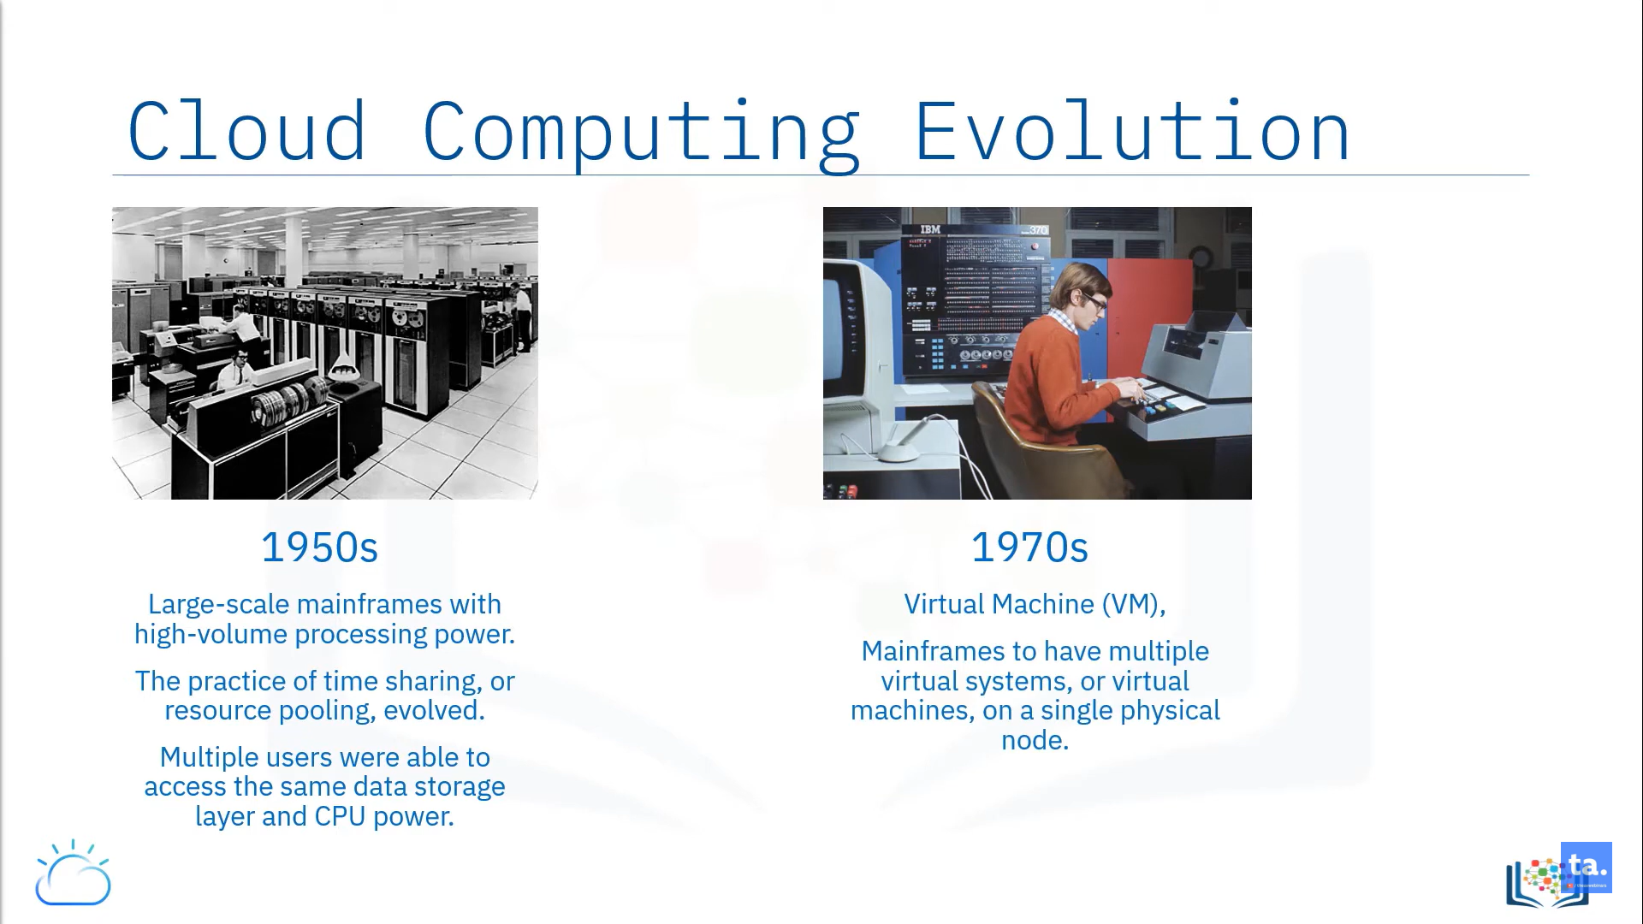
EVOLUTION OF CLOUD OR HISTORICAL DEVELOPMENT
Dept. of ISE

Slide 18
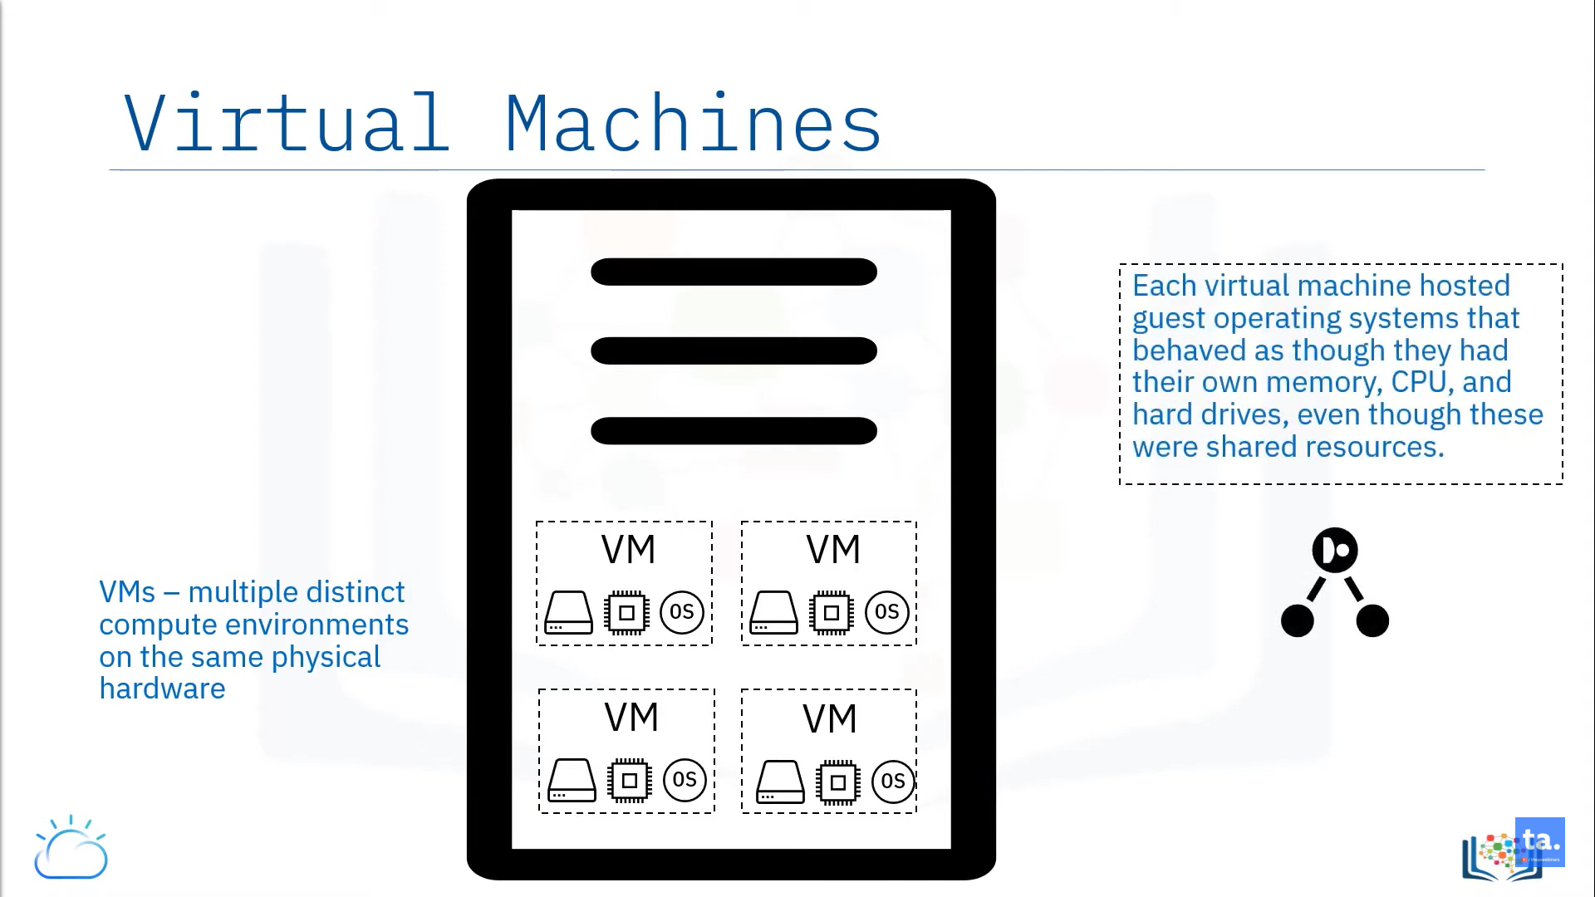
VIRTUAL MACHINES:
Dept. of ISE

Slide 19
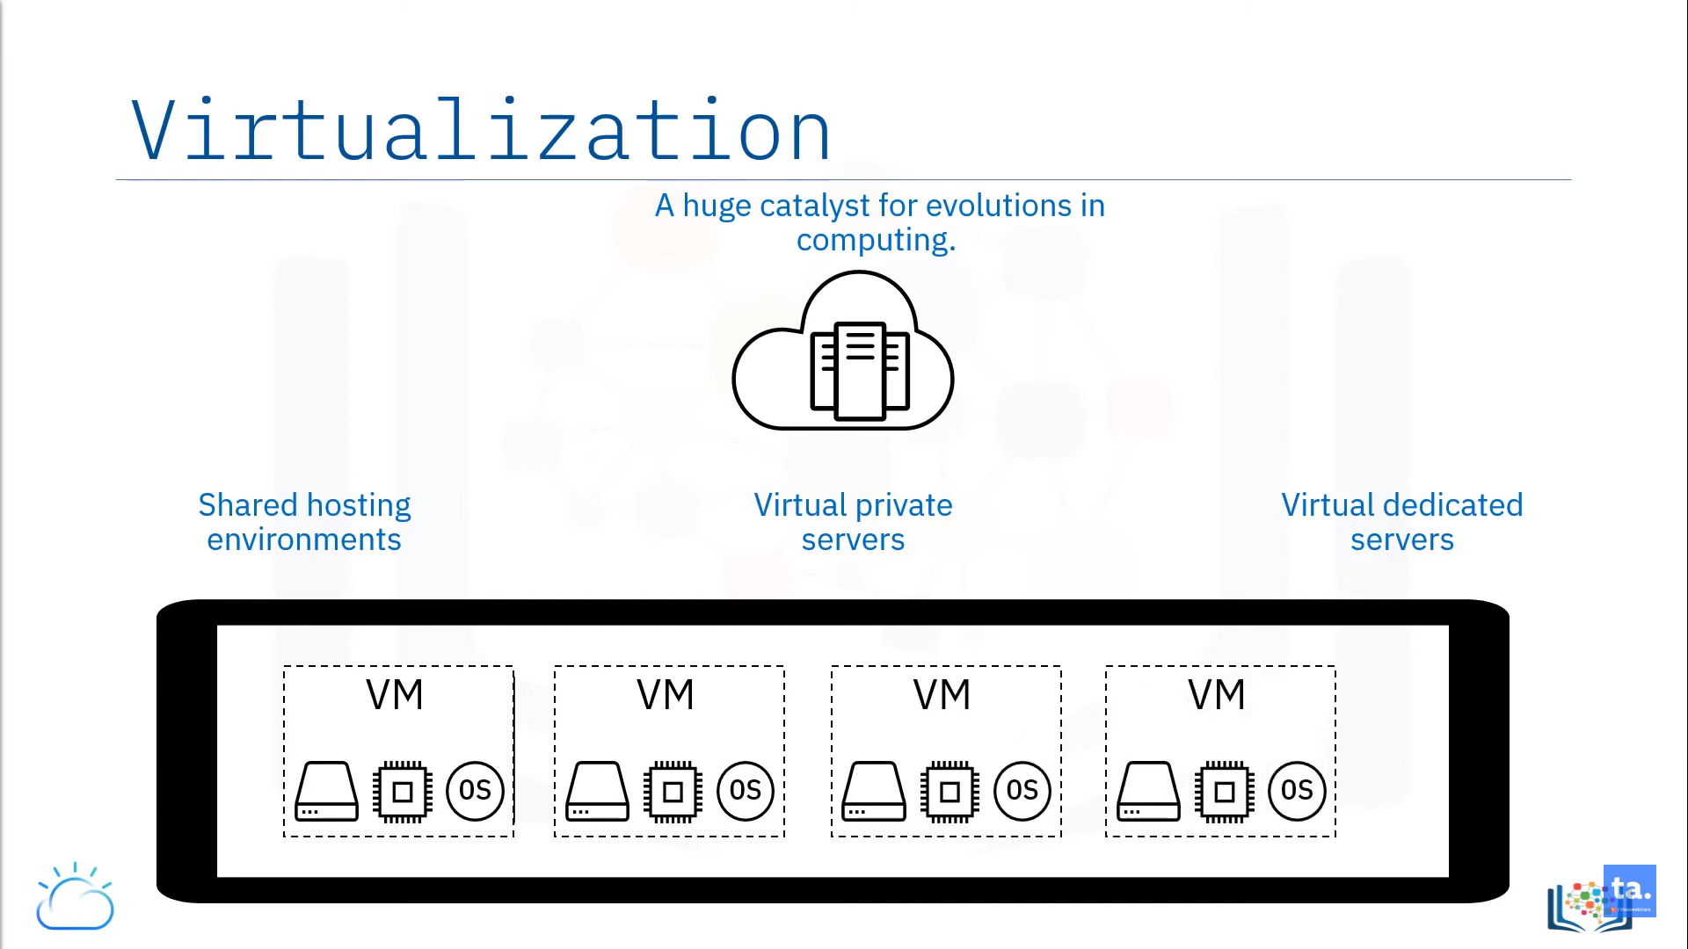
VIRTUALIZATION
Dept. of ISE

Slide 20
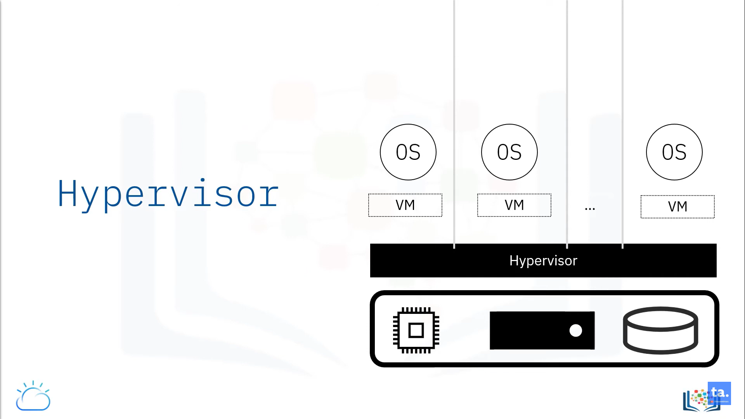
HYPERVISOR
Dept. of ISE

Slide 21
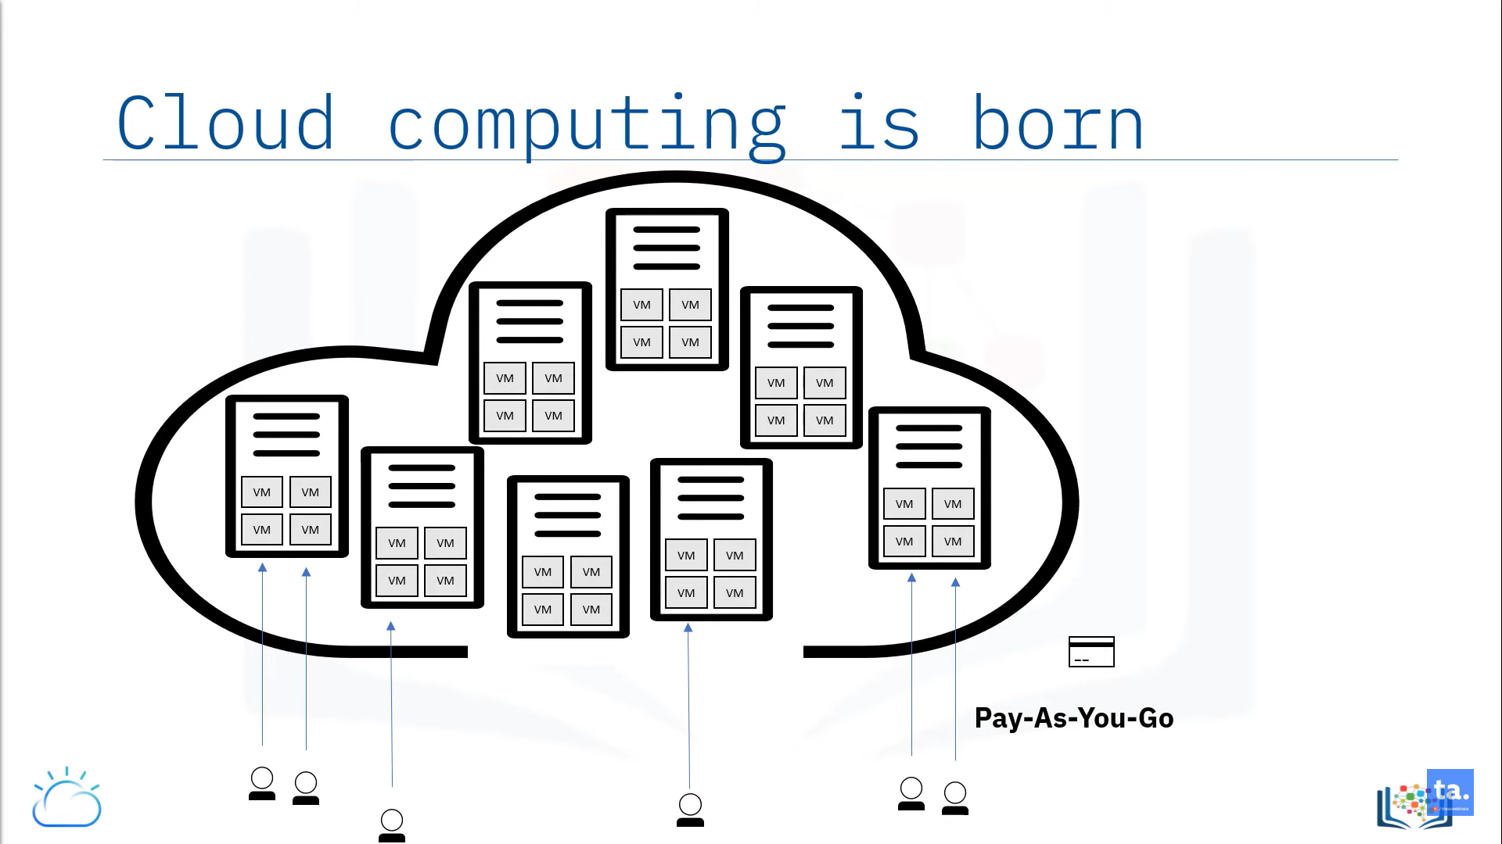
Dept. of ISE

Slide 22
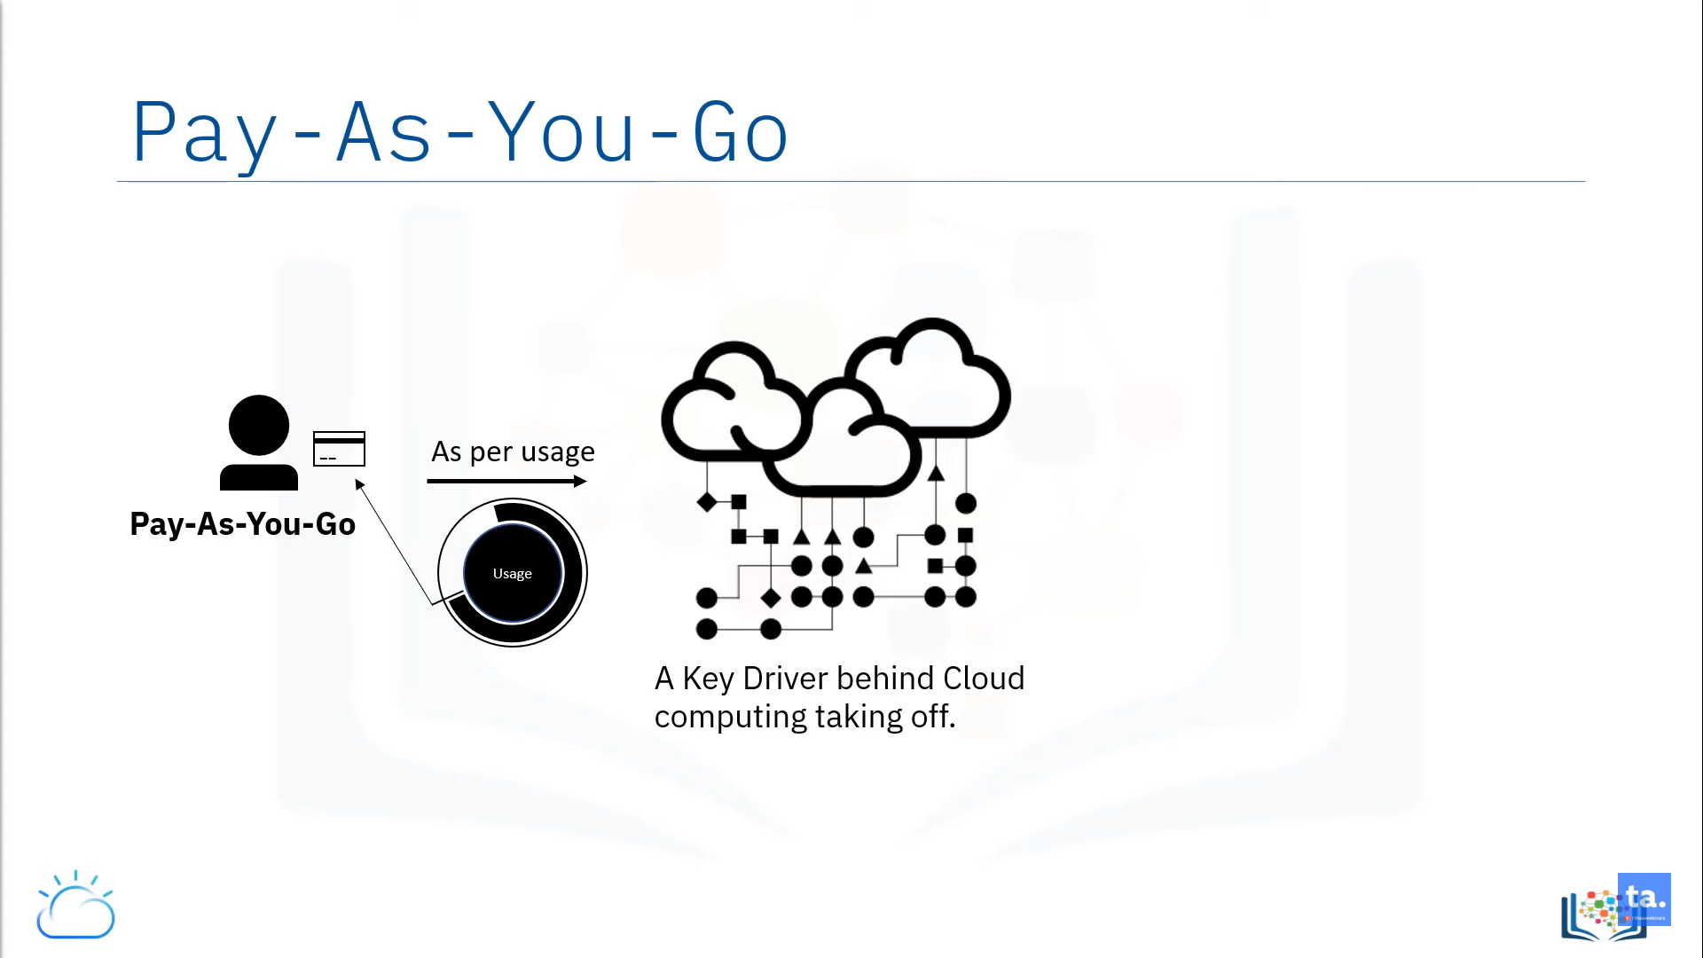
Dept. of ISE

Slide 23
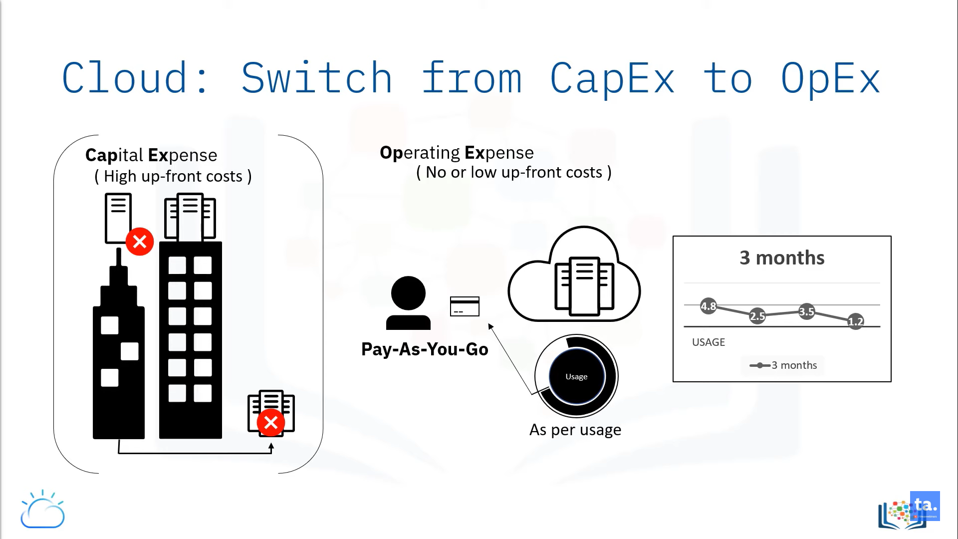
Dept. of ISE

Slide 24
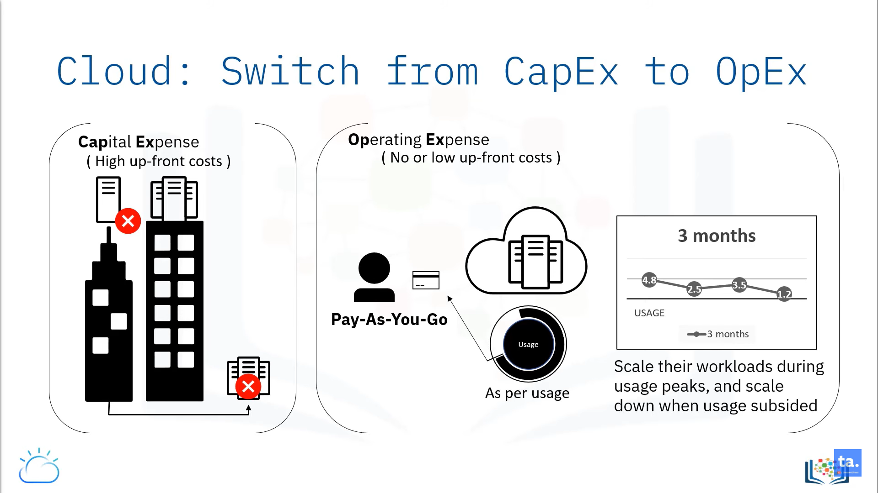
Dept. of ISE

Slide 25
Building Cloud computing Environment:
The creation of cloud computing environments encompasses both the development of applications and systems.
• These developments that leverages cloud computing solutions and the creation of frameworks, platforms and infrastructure delivery cloud computing services.
Dept. of ISE

Slide 26
Application Development
Applications that leverage cloud computing benefit from its capability to dynamically scale on demand.
Web application is the application which takes the biggest advantage of this feature.
Enterprise application :- This application that leverages the internet as the preferred channel for service delivery and user interaction. This application is the complex process which is the interaction with users and develop through the interaction between several tiers behind the web front end.
Dept. of ISE

Slide 27
Resource-intensive applications:-
This application can either be data-intensive or compute-intensive application
.• For both cases, the considerable amount of resources are required to complete the execution in a reasonable timeframe.
.• That the large amount of resources are not needed constantly or for a long duration.
ex: Scientific application require huge computing capacity to perform large scale experiments once in a while.
Dept. of ISE

Slide 28
Cloud computing provides a solution for on-demand and dynamic scaling across the entire stack of computing. This is achieved by
Providing methods for renting compute power , storage and networking.
Offering runtime environments designed for scalability and dynamic sizing.
Providing application services that mimic the behavior of desktop applications but that are completely hosted and managed on the provider side.
Dept. of ISE

Slide 29
2. Infrastructure and System development
Distributed computing, virtualization, service Orientation, and Web 2.0 form the core technologies enabling the provisioning of cloud services from anywhere on the globe.
I) Distributed computing is a foundational model for cloud computing because cloud systems are distributed systems. The major challenges for developers is that where the new nodes and services are provisioned on cloud. Infrastructure-as-a-service solutions provide the capabilities to add and remove resources. Platform-as-a-service solutions embed into their core offering algorithms and rules that control the provisioning process and lease of resources.
Dept. of ISE

Slide 30
II) Web 2.0 technologies constitute the interface through which cloud computing services are delivered, managed, and provisional.
The interaction with rich interfaces through the web browser, Web services have become the primary access point to cloud Computing systems from a programmable standpoint
III) Service Orientation is the underlying paradigm that defines the architecture of a cloud computing system. Xaas - Everything-as-a-service that clearly underlines the central role of Service Orientation.
Dept. of ISE

Slide 31
IV) Virtualization is another element that plays a fundamental role in cloud computing.
These are all considerations that influence the way we program applications and systems based on cloud computing technologies.Cloud computing provides mechanisms to address surges in demand by replicating the required components of computing.
Dept. of ISE

Slide 32
3. Computing platform and technologies
Development of a cloud computing applications happens by leveraging platforms and frameworks that provide different types of services, from the bare-metal infrastructure to customizable applications serving specific purposes.
Amazon web services(AWS) AWS provides different wide-ranging clouds laaS services, which ges from virtual compute, storage, and networking to complete computing stacks. AWS is well known for its storage and compute on demand services, named as Elastic Compute Cloud (EC2) and Simple Storage Service (S3). EC2 also offers the capability of saving an explicit running instance as image, thus allowing users to create their own templates for deploying system.
Dept. of ISE

Slide 33
Google AppEngine
Google AppEngine is a scalable runtime environment frequently dedicated to executing web applications. These utilize benefits of the large computing infrastructure of Google to dynamically scale as per the demand. AppEngine offers both a secure execution environment and a collection of which simplifies the development if scalable and high, Performance Web applications.
• Microsoft AzureMicrosoft Azure is a Cloud operating system and a platform in which user can develop the applications in the cloud. Generally, a scalable runtime environment for web applications and distributed applications is provided.
Dept. of ISE

Slide 34
• Hadoop
Apache Hadoop is an open source framework that is appropriate for processing large data sets on commodity hardware. Hadoop is an implementation of MapReduce, an application programming model which is developed by Google. This model provides two fundamental operations for data processing: map and reduce.
Force.com and Salesforce.comForce.com is a Cloud computing platform at which user can develop social enterprise applications. The platform is the basis of SalesForce.com - a Software-as-a-Service solution for customer relationship management.
Dept. of ISE

Slide 35
Manjrasoft Aneka
Manjrasoft Aneka is a cloud application platform for rapid creation of scalable applications and their deployment on various types of clouds in a seamless and elastic manner. It supports a collection of programming abstractions for developing applications and a distributed runtime environment that can be deployed on heterogeneous hardware.
Dept. of ISE

Slide 36

Dept. of ISE

